Slide 1
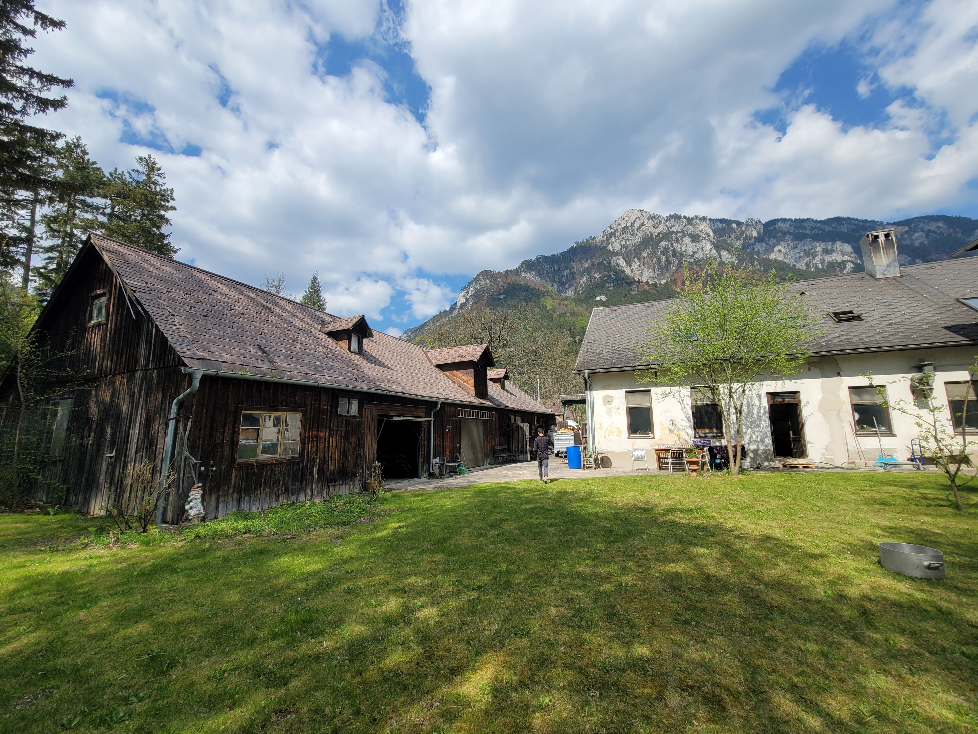
6th Edition — August 16-22, 2026
Crypto Commons
Gathering 2026
Sponsorship Partnership Deck
Commons Hub, Austrian Alps · cryptocommonsgather.ing
CCG 2026
01

Slide 2
ABOUT THE GATHERING
A week-long unconference where crypto meets the commons
The Crypto Commons Gathering is an annual retreat in the Austrian Alps where builders, researchers, and activists working on regenerative finance, cooperative economics, and commons-based infrastructure come together for a week of co-living, co-creating, and radical imagination.
6th
60+
15+
∞
Now in its 6th edition, CCG has become the premier gathering for the people building post-capitalist economic infrastructure. Not a conference — a convivium.
Annual Edition
Participants
Countries
Real Value
Produced
CCG 2026
02

Slide 3
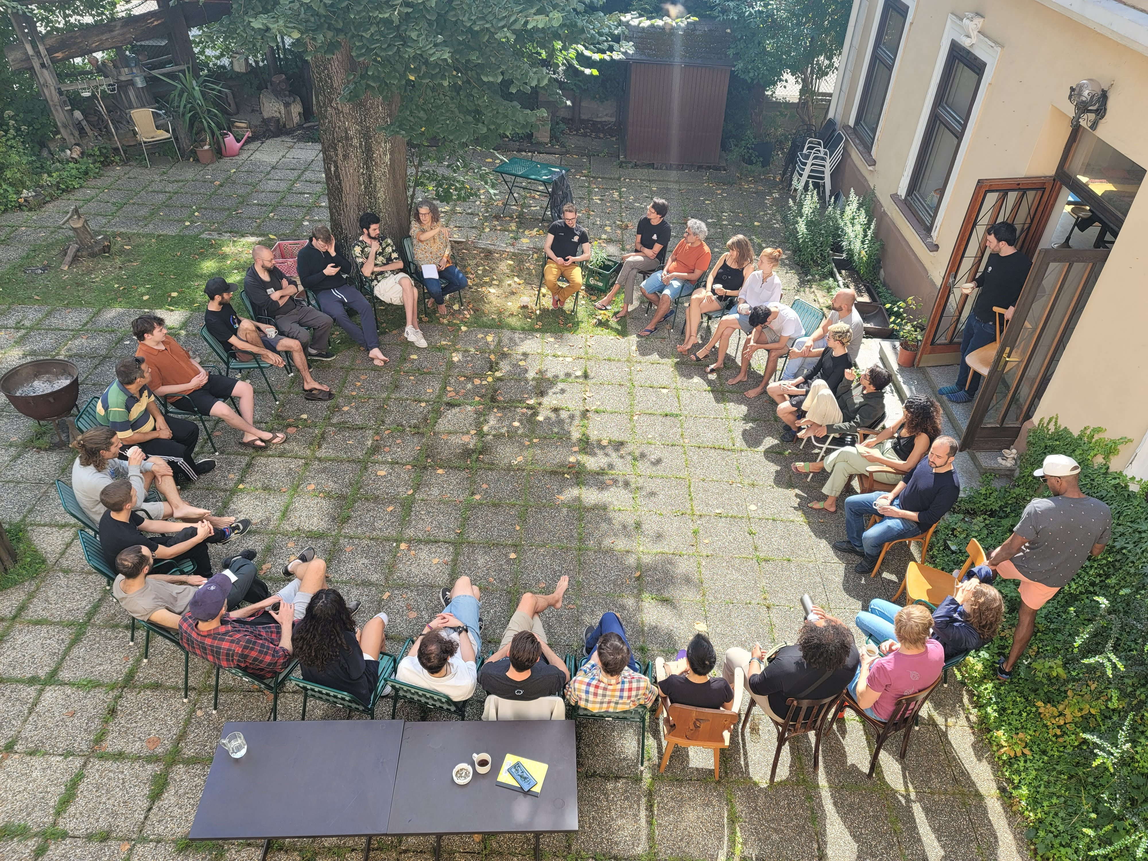
TRACK RECORD
Real impact across five editions
300+
Movements Catalyzed
#ReFi — Regenerative Finance: catalyzed at CCG, ReFi Unconference (2022)
Total Attendees Across Five Editions
#CoFi — Cooperative Finance: redefining collaborative financial infrastructure
#MycoFi — Mycelial Finance: biomimetic approaches to economic design
Builders, researchers, activists, artists, and funders from 15+ countries.
New protocols, collaborative frameworks, and digital public infrastructures have emerged from these gatherings.
Teams from Commons Stack, BlockScience, Regen Network, EthicHub, Circles UBI, ReFi DAO, Holochain, Economic Space Agency, zkNetwork, and more.
CCG 2026
03

Slide 4
WHY PARTNER WITH US
Four reasons to sponsor CCG
Reach Influential Builders, Thought Leaders & Decision Makers
Association with Real Impact
ReFi protocol teams, DAO governance researchers, cooperative founders, academic researchers, and impact investors. Decision-makers you won't find at traditional crypto conferences.
CCG has catalyzed #ReFi, #CoFi, and #MycoFi — movements shaping regenerative finance. Your brand joins a legacy of genuine innovation.
Values-Aligned Audience
Six Years of Trust
These aren't casual observers. They lead projects with real traction, make purchasing decisions, and influence discourse across crypto-commons and open source.
Complete financial transparency. Non-extractive economics. Participant-driven format. 500+ active community members. No one profits — all funds serve the gathering.
CCG 2026
04

Slide 5
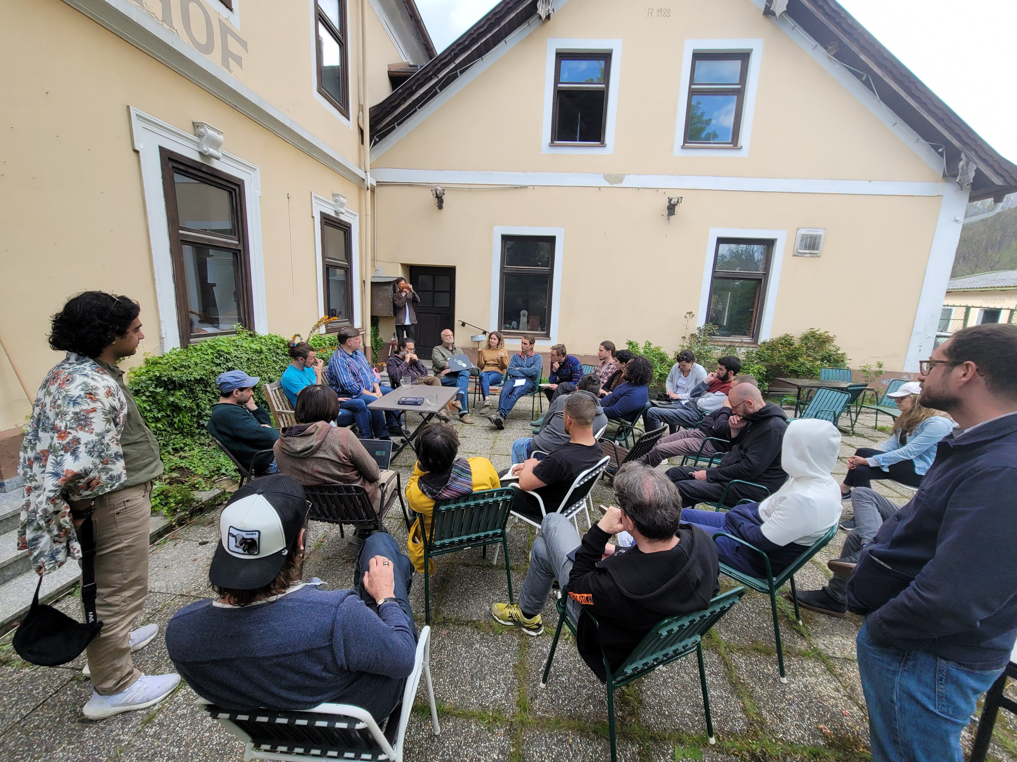
WHO YOU'LL REACH
60+ participants from 15+ countries
Not casual observers — committed builders who influence discourse and make decisions for their organizations.
35%
25%
15%
Builders & Devs
Researchers
Artists & Designers
Protocol engineers, smart contract devs, infrastructure builders
PhD students, professors, think tank members, policy experts
Game designers, solarpunk creators, UX/UI specialists
15%
10%
60%
Activists & Organizers
Investors & Funders
Based in Europe
Cooperative founders, community organizers, policy advocates
Impact investors, grant makers, ecosystem funders
20% N. America, 15% Global South, 5% Asia-Pacific
CCG 2026
05

Slide 6
PARTNERSHIP TIERS
Three ways to support CCG 2026
We're seeking €10,000–15,000 in total sponsorship. Every contribution makes CCG more accessible and impactful.
MYCELIUM
SPORE
FRIEND OF THE COMMONS
€5,000
€2,500
€1,000
RECOGNITION
RECOGNITION
RECOGNITION
✓ Logo on website hero & all pages
✓ Logo on website sponsor section
✓ Name/logo on supporters section
✓ Featured on all event materials & badges
✓ Logo on event signage
✓ Social media thank-you
✓ Opening & closing acknowledgment
✓ Social media mention
✓ Ceremony acknowledgment
✓ Social media across all channels
ENGAGEMENT
ENGAGEMENT
ENGAGEMENT
✓ 1 event ticket
✓ 1 event ticket at 50% off
✓ 2 event tickets, lodging and food
✓ Priority registration
✓ 30-min sponsored session slot
CONTENT & MEDIA
✓ Participant introductions
✓ Event newsletter mention
CONTENT & MEDIA
✓ Post-event summary inclusion
✓ Pre-event spotlight
✓ Post-event report feature
✓ "Official Sponsor" usage rights
CCG 2026
06

Slide 7
LEAD PARTNER
WHAT YOU GET
MYCELIUM
✓ 2 event tickets, lodging and food to the week-long gathering
✓ 30-minute sponsored session — workshop, presentation, or demo
✓ Logo on website hero section and every page
✓ Featured on all event materials, badges, and signage
✓ Acknowledgment at opening and closing ceremonies
✓ Social media spotlight across all CCG channels
✓ Spotlight in pre-event communications to 500+ members
✓ Dedicated feature in post-event report
✓ Rights to use "Official Sponsor of CCG 2026"
✓ Participant introductions (with consent)
€5,000
Become part of the CCG ecosystem. Maximum visibility, meaningful engagement, and lasting association with the commons movement.
"The ideas I encountered at CCG completely changed how I think about protocol design. It's like nothing else in the crypto space."
— ReFi builder, 2023
CCG 2026
07

Slide 8
SUPPORTER
WHAT YOU GET
✓ 1 event ticket to the week-long gathering
✓ Priority registration — secure your spot before public sales
✓ Logo on the website sponsor section
✓ Logo on event signage at the Commons Hub
✓ Social media mention across CCG channels
✓ Named in event newsletter to 500+ subscribers
✓ Included in post-event summary and documentation
SPORE
€2,500
Plant seeds for regenerative futures. Meaningful recognition and a direct connection to the community, at an accessible investment level.
"CCG is where I found my people — the ones who actually believe another world is possible and are building it together."
— Returning participant, 2024
CCG 2026
08

Slide 9
SOLIDARITY
WHAT YOU GET
FRIEND OF
THE COMMONS
✓ 1 event ticket at 50% off — attend the full gathering at half price
✓ Name or logo on the website supporters section
✓ Social media thank-you post across CCG channels
✓ Acknowledgment at opening and closing ceremonies
€1,000
Show solidarity with the movement. Every contribution helps keep CCG accessible and makes a real difference for participants who need support.
"I came for the unconference, I stayed for the community. Four years later, my closest collaborators are people I met at CCG."
Perfect for individuals, small organizations, and cooperatives who want to show support for commons-based futures.
— Cooperative founder, 2022
CCG 2026
09

Slide 10
FULL TRANSPARENCY
Where your sponsorship goes
Estimated Event Budget
Revenue Sources
Food & catering
€8,500
Food contributions
~€8.5k
6 days, 60+ participants
Venue
€5,000
Facility, electricity, water, internet
Accessibility & travel support
€3,500
Grants, subsidies, accommodations
Ticket sales
~€7k
Event coordination
€3,000
Part-time logistics & comms
Design & marketing
€2,000
Branding, print materials, outreach
Sponsorship gap
€10–15k
Documentation & media
€1,500
This is where your support makes the difference.
Photo, video, written summaries
Supplies & admin
€1,500
Materials, insurance, processing
No organizer profits
Total
€25,000
All organizing team members cover their own expenses. Full budget published publicly.
CCG 2026
10

Slide 11
BEYOND FINANCIAL SPONSORSHIP
Alternative partnerships welcome
Track Sponsorship
Accommodation
Meal Sponsorship
Custom pricing
~€3,000–5,000
~€2,000–4,000
Sponsor a specific theme track with naming rights and session curation involvement.
Cover accommodation for participants who need financial support, broadening access.
Sponsor catered meals — your name becomes synonymous with nourishment and care.
Documentation
Travel Grants
Tech Partnership
~€1,500
Custom
In-kind
Support professional photography, videography, and written summaries with credit.
Fund travel scholarships for participants from underrepresented regions or backgrounds.
Provide tools, platforms, or infrastructure (streaming, collaboration) in exchange for recognition.
CCG 2026
11

Slide 12
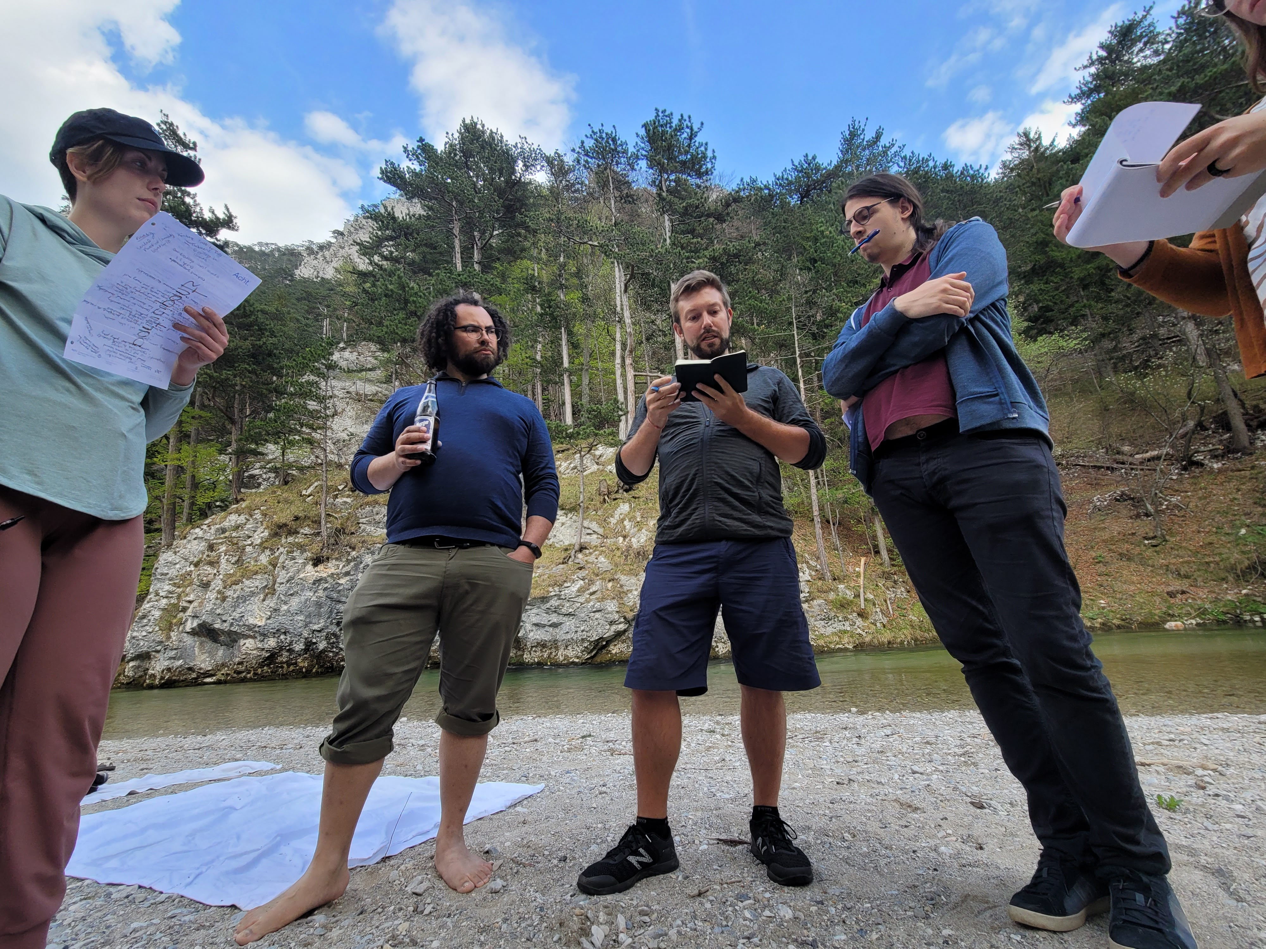
Let's build together.
We're not seeking logo placement in exchange for attention.
We're seeking partners who share our vision of regenerative,
cooperative, and commons-based futures.
Get in touch
contact@cryptocommonsgather.ing
Learn more
cryptocommonsgather.ing/sponsorships
Bonus: Valley of the Commons takes place at the same venue immediately after CCG — sponsors gain extended visibility across both events.
Crypto Commons Association · Commons Hub, Reichenau an der Rax, Austria
CCG 2026
12

